Slide 1


Accident Prevention and Response for Cryogenic Chemicals
Matt Spencer, CSP, SHRM-CP
Director of HR & Safety Programs
April 18, 2023
The All-Feather Association

Slide 2

Who We Are
USPOULTRY is the world's largest poultry organization. Membership includes producers and processors of broilers, turkeys, eggs, breeding stock, and ducks, as well as allied companies. We have member companies worldwide and 27 affiliated state associations.
The All-Feather Association

Slide 3
Accident Prevention and Response for Cryogenic Chemicals
Overview –
Brief Overview of Foundation Foods Tragedy and the Investigation and Findings.
Development of Draft Cryogenic Toolkit.
Q/A and Collaboration Discussions.

Slide 4
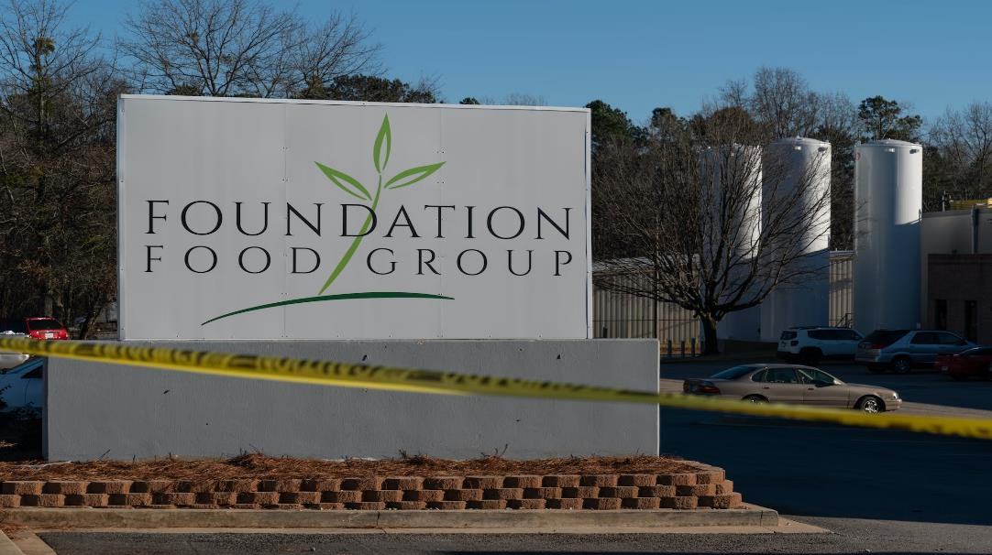
January 28, 2021, Gainesville, Georgia, six people were killed by asphyxiation and twelve were injured when a liquid nitrogen leak occurred inside a poultry processing plant.

Slide 5
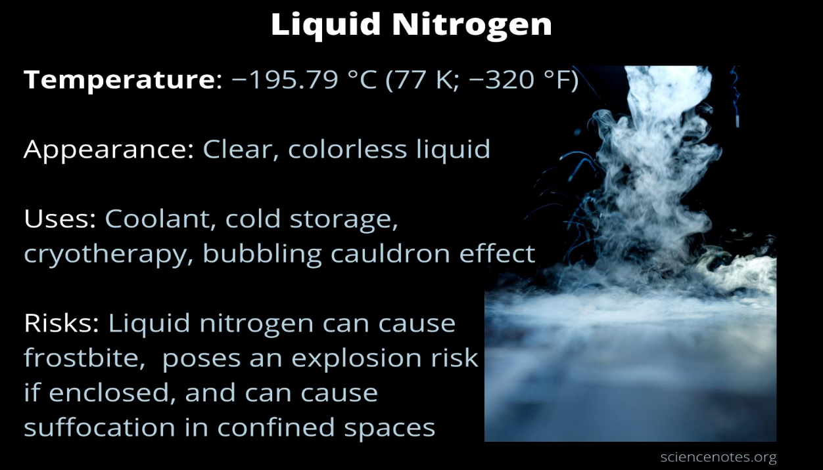
Foundation Foods Tragedy

Slide 6
Foundation Foods Tragedy
At 10:13 a.m. on January 28, 2021, three maintenance employees were in a freezer room troubleshooting improperly frozen cooked chicken parts discharging from the liquid nitrogen Immersion and Spiral Freezer.
Nitrogen Immersion Freezers are a reliable method for processing individually quick-frozen foods like chicken breasts, pizza toppings, strawberries, and shrimp. Immersion freezing is one of the quickest ways to freeze while locking important nutrients, moisture, and flavor into the food.

Slide 7
Immersion freezers
Cryogenic immersion is the fastest method of freezing.
Food products are submersed in a bath of liquid nitrogen
(at approximately -320 °F. The outside surface
hardens instantly.
Spiral freezers
With cryogenic spiral freezing, foods travel on a conveyor
belt that wraps around a drum through the freezer. Spiral
freezers average about 10 to 12 ft. high. The spiral belt
design accommodates high volumes of food products in
less floor space, while applying a controlled freeze rate to
the food product.

Slide 9
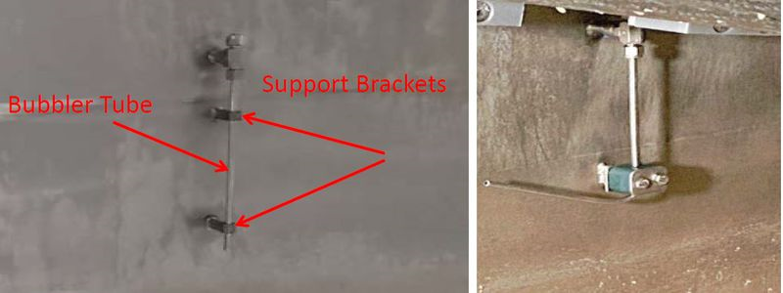
Foundation Foods Tragedy
One of the maintenance employees, who was troubleshooting the freezer, used a tool to bend the bottom of the stainless-steel bubbler system dip tube upward inside the tub of the immersion freezer.
The bubbler system was part of the liquid control system that maintained the liquid nitrogen level in the immersion freezer tub.
Support Brackets
Bubbler Tube

Slide 10

Soon after the freezer was restarted, liquid nitrogen in the immersion freezer tub overflowed onto the floor due to the damaged dip tube.
The liquid nitrogen spilled out of the freezer converted to vapor due to the changes in temperature and pressure and displaced oxygen from the air.
The three maintenance employees succumbed to the oxygen-deficient atmosphere in the freezer room.
The plant superintendent, a maintenance employee, and a quality control technician went to the freezer room and attempted to help the employees when they also died due to the oxygen-deficient atmosphere.

Slide 11
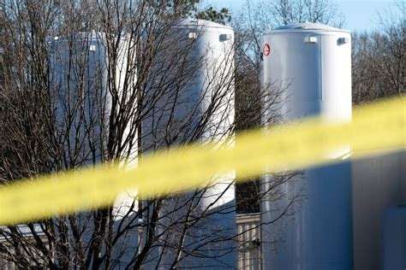
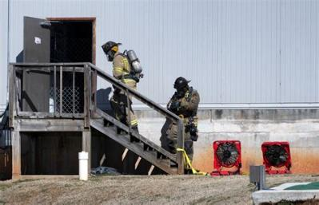
A large release of liquid nitrogen rapidly converted to a gas. Nitrogen gas is heavier than air and forces oxygen out of the room.
The liquid nitrogen is stored in tanks external to the building, in the parking lot. The plant receives 2-3 tanker loads per day of liquid nitrogen.
The facility Maintenance Manager described personally closing the isolation valves of the tanks and shutting off supply to the building during the release. The investigation determined two tanks of liquid nitrogen were released.
Fire officials documented temperatures as low as -100 °F on entry.
Major portions of the Liquid Nitrogen system, including interior and exterior tanks and equipment, were installed and commissioned only 4-6 weeks before the event.

Slide 12
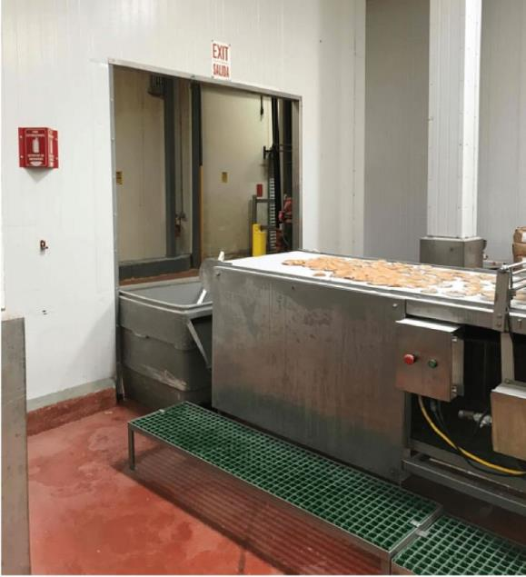
Foundation Food Group Investigation
OSHA investigation of the Incident
OSHA, on July 23, 2021, issued a total of 59 violations and proposed fines of $998,637 to Foundation Food Group and three other companies.
Some Violations issued:
Multiple egress paths in the facility were blocked and not free from obstruction.
Workers were not trained on the emergency procedures related to liquid nitrogen and anhydrous ammonia.
No adequate lockout procedures were used or coordinated lockout procedures conducted with contractors.

Slide 13

Foundation Food Group Investigation
CSB contacted USPOULTRY to collaborate on training and education resources for the industry. CSB investigation is slated for completion in 2023.
Process Hazard Analysis (PHA) on Cryogenic Chemical Usage in the Poultry Industry
Survey conducted to better understand the level of usage of these chemicals in the industry.
An estimated 220 facilities utilize these chemicals, and approximately 13,000 workers are employed.
50% utilize company safety professionals to train on usage and inspect the safety of these systems, while the other 50% utilize the equipment manufacturers or chemical providers for this purpose.
A Process Hazard Analysis identified the need to develop training materials and programs for industry employees and first responders.

Slide 14
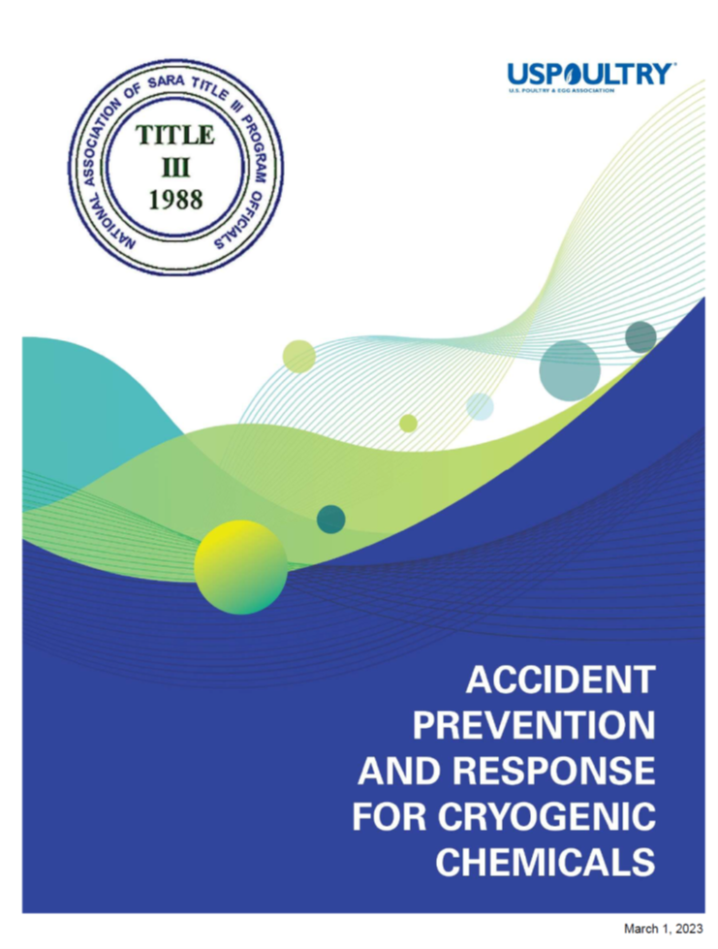
Accident Prevention and Response for Cryogenic Chemicals
Cryogenic Liquids - Focus on Liquid Nitrogen, Liquid Carbon Dioxide, and Liquid Oxygen.
Physical Properties – Review of characteristics of chemicals.
Cryogenic Liquid Uses in Food Processing – How the industry utilizes these chemicals.
Hazards of Cryogenic Liquids.

Slide 15
Accident Prevention and Response for Cryogenic Chemicals
Personnel Protective Equipment (PPE) – Eye and Skin thermal protection.
Safe Handling and Storage Practices – Ventilation and Thermal Expansion.
First Aid for Cryogenic Exposures – Familiar with treating frostbite.
Cryogenic Liquid Safety Tools - Air Monitoring.
Emergency Response Procedures – Evacuation and Control of Vapor Cloud.

Slide 16
Upgraded Nitrogen System
Normal Nitrogen Systems
Emergency Stop Triggered by:
2 Bubbler Tube
6 Emergency Stop Buttons Around Machine
5 Oxygen Sensors in the Room
1 Overflow sensor
Personal 4-5 with personal Oxygen Monitors
Emergency Stop Makes This Happen:
Ventilation in room opens to maximum makup air and speed maxes out.
4 Exhaust ventilation fans come on
  Fans have a generator backup, so they work during a power outage.
10 Auto Valves Shut Off - Liquid Nitrogen Flow
  One per tank, On Roof, In Room
Lid on machine remains closed.
Evacuation alarm will sound.
Lights on the outside of room indicate Oxygen level in the room.
Emergency Stop Triggered by:
1 Bubbler Tube
2 Emergency Stop Buttons
1 Oxygen Sensor
Emergency Stop Makes This Happen:
2 Exhaust ventilation fans come on
4 Valves Shut Off Liquid Nitrogen Flow
Lid on the machine remains closed.

Slide 17
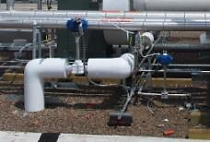
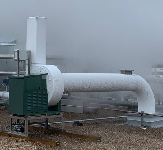

= Nitrogen Flow
Refrigeration
Tanks
Roof
LIQUID
NITROGEN
LIQUID
NITROGEN
LIQUID
NITROGEN
LIQUID
NITROGEN
Room
Chicken
Freezer
Immersion
Chicken
Liquid Nitrogen

Slide 18
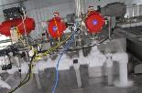

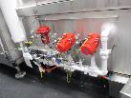
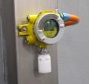
EXHAUST
Makeup Air
Roof
Room
5
Fresh Air
Fresh Air
Freezer
Chicken
1
2
3
4
Immersion
Chicken
Liquid Nitrogen

Slide 19
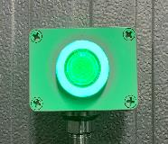
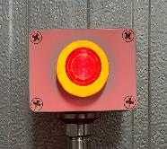
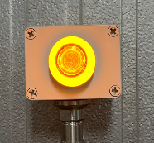
OXYGEN WARNING LIGHTS
The danger of Nitrogen gas is that, when released, it will reduce the Oxygen level in the room. We test for proper Oxygen levels in the room to ensure safety.
Green: Oxygen levels are safe.
Red: Oxygen levels are
not safe. DO NOT ENTER
Oxygen Warning Lights are located on the outside of the room.
This allows you to know the room is safe to enter before you enter the room.
Yellow: System fault. Call
maintenance to investigate.

Slide 20
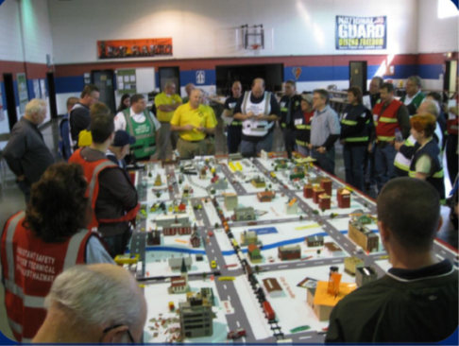
Accident Prevention and Response for Cryogenic Chemicals
Emergency Preparedness and Response identified needs:
Identify needs relating to emergency management principles of prevention, protection, preparedness, response, and recovery.
•Develop resources on creating emergency response plans
and procedures with Local EMS.
•Create resources and train on performing emergency exercises
for various scenarios (Table-top exercises).
•Outline specified training requirements (OSHA, DHS, etc.).
•Develop resources for emergency aid needs so the industry can
ensure availability of supplies and equipment.

Slide 21

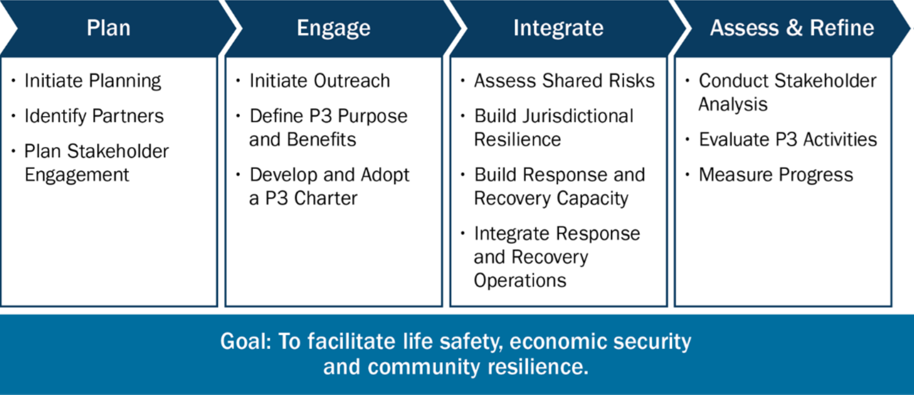
Coordinate Emergency Planning with Public Emergency Officials
The P3 Development Process
A P3 for emergency management is any informal or formal cooperative arrangement between two or more organizations of private industry and the public sector for their mutual benefit. It is designed to ensure jurisdictions' life safety, economic security, and resilience. The guide provides a simple process to create or refine P3s.

Slide 22
Coordinate Emergency Planning with Public Emergency Officials
The P3 Development Process
Include Local Advocates and Service Provider
Local advocates and service providers for vulnerable and disadvantaged communities are in a good position to advise what is needed for mitigating risks pre-disaster and for advising what is needed post-disaster. Include:
State and federal benefit providers and employers
Agencies that support housing benefits
Providers of any form of special or mass transportation or special transport providers
Healthcare providers to include specialized care providers
Providers of community lifelines with special emphasis on local providers lower-cost goods and services
Local non-governmental organizations (NGO) and faith-based organizations

Slide 23
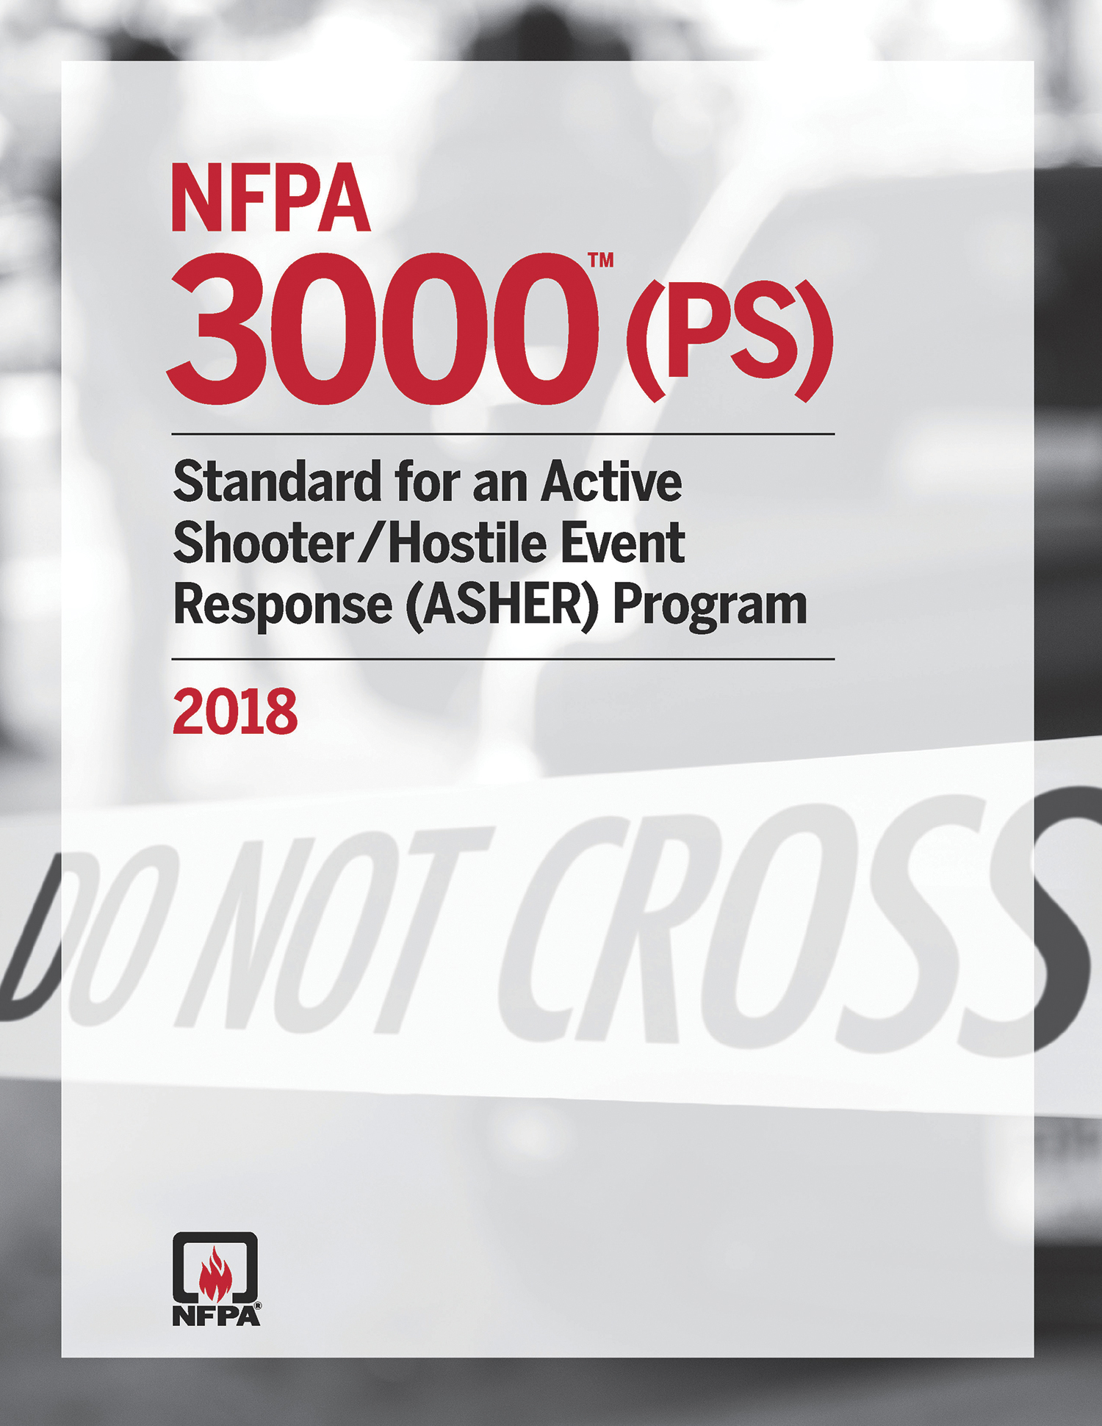
Coordinate Emergency Planning with Public Emergency Officials
NFPA 3000, Standard for an Active Shooter / Hostile Event Response (ASHER) Program
The ASHER Program is a standard developed by the NFPA in response to the growing number of active shooter events throughout the United States. This standard is not only essential but also comprehensive, as it addresses the many and varied aspects of the process, including:
* identifying hazards,
* assessing vulnerability,
* planning,
* resource management,
* incident management at a command level,
* competencies for first responders, and
* recovery.

Slide 24
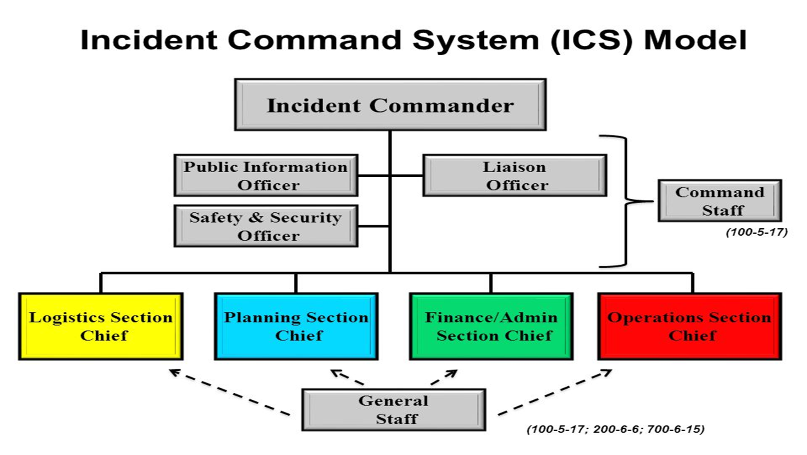
Coordinate Emergency Planning with Public Emergency Officials
An ASHER program details how fire departments and EMS agencies can aid in preparing, responding, mitigating, and recovering from a situation involving a mass shooting or other mass casualty incident.
The ASHER program uses established systems and practices such as the National Incident Management System (NIMS) and the Incident Command System (ICS), including Unified Command.
NFPA 3000 allows individuals outside of fire and EMS to know and understand how those first responders will operate at the scene of an active shooting. This document also opens lines of communication before, during, and after events and outlines roles and responsibilities. The result is less likelihood of duplication of effort in chaotic environments.

Slide 25
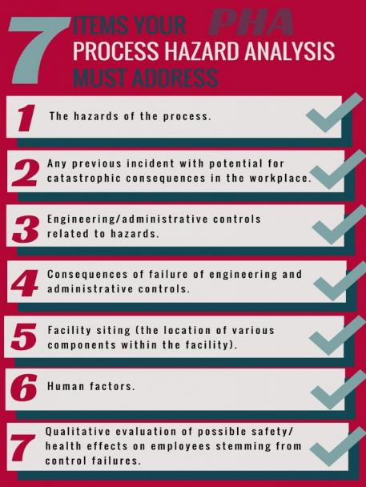
Process Hazard Analysis (PHA) – The method for identifying and evaluating process hazards and the controls needed to reduce those hazards. This analysis is audited every five years and any findings or recommendations must be addressed in a timely fashion. Those corrections must be discussed with any employees that may be affected.

Slide 26
QUESTIONS ?
Thank you for all your support!
Matt Spencer, CSP, SHRM-CP
U.S. Poultry & Egg Association
mspencer@uspoultry.org
678-514-1982

